Slide 1
Simultaneous Analysis of Eye Tracking and Autonomic Signals during Emotional and Cognitive Processing
Submitted in the partial fulfillment for the award of the degree of
BACHELOR OF ENGINEERING
IN
Artificial Intelligence and Machine Learning
Submitted by:
Arshdeep Yadav (22BAI70007)
Aryan Kesarwani (22BAI70016)
Mayank Chouhan (22BAI70050)
Divya (22BAI70062)
Under the Supervision of:
Er. Aaskaran Bishnoi
E15060
Assistant Professor
AIT-CSE AIML
Department of AIT-CSE
DISCOVER . LEARN . EMPOWER

Slide 2
Outline
Introduction to Project
Problem Formulation
Objectives of the work
Methodology Used
Results and Outputs
Conclusion
Future Scope
References

Slide 3
Introduction to Project
The research investigates the relationship between ocular dynamics (eye-tracking signals) and autonomic indices during emotional and cognitive processing in older adults, focusing on distinguishing late-life depression (LLD) from healthy aging.​
It emphasizes the importance of objective, non-invasive real-time methods like eye tracking and autonomic signal measurement for understanding disease mechanisms and improving screening tools for elderly populations.​

Slide 4
The study expands on previous work by integrating video-based eye metrics with autonomic signals (pupillometry, heart rate variability (HRV), electrodermal activity (EDA)) to develop scalable biomarkers for clinical assessment

Slide 5
Problem Formulation
There is a significant gap in research regarding the coordinated analysis of microsaccadic behavior and autonomic responses in late-life depression. Most prior studies have investigated these markers separately, restricting mechanistic understanding in diverse populations.​
The superior colliculus and locus coeruleus are believed to jointly control both fine-scale microsaccades and sympathetic pupil dynamics in emotional conflict, but comprehensive trial-level multimodal analysis is lacking.

Slide 6
Objectives
Evaluate common and distinct features of conflict-related arousal and control via simultaneous analysis of eye-tracking and autonomic signals in LLD versus healthy controls.​
Determine whether integrated ocular-autonomic traits can reliably differentiate late-life depression from healthy aging and reveal neural mechanisms underlying emotional conflict in older adults.​
Develop clear, scalable biomarkers for emotion recognition, cognitive workload assessment, and geriatric mental health monitoring.

Slide 7
Methodology
Participants: 70 older adults (35 LLD, 35 healthy controls), matched for age and cognitive background, underwent standardized diagnostic screening and vision checks.​
Experimental Setup: Participants performed an emotional face-word Stroop task involving congruent and incongruent facial expression-word pairs, while high-speed binocular eye tracking (EyeLink-1000 Plus, 500 Hz) collected gaze position, pupil size, and blinks under controlled lighting and fixation protocols.​

Slide 8
Data Preprocessing: Artifact removal, resampling, calibration of pupil size, and rigorous outlier exclusion ensured high data quality; trials were temporally aligned and features extracted for microsaccade rate, amplitude, velocity, angle, and autonomic-linked dynamics.

Slide 9
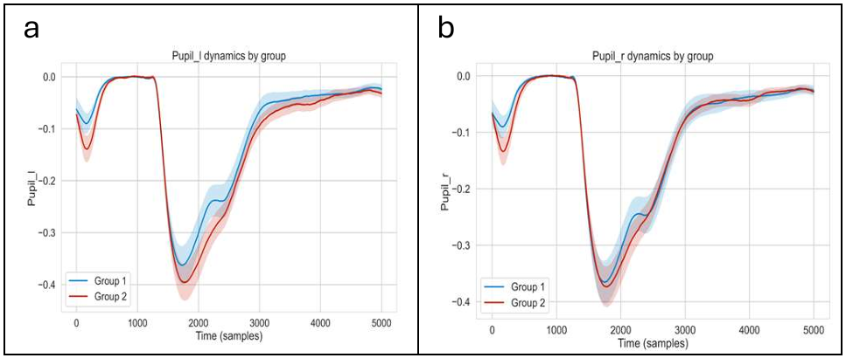
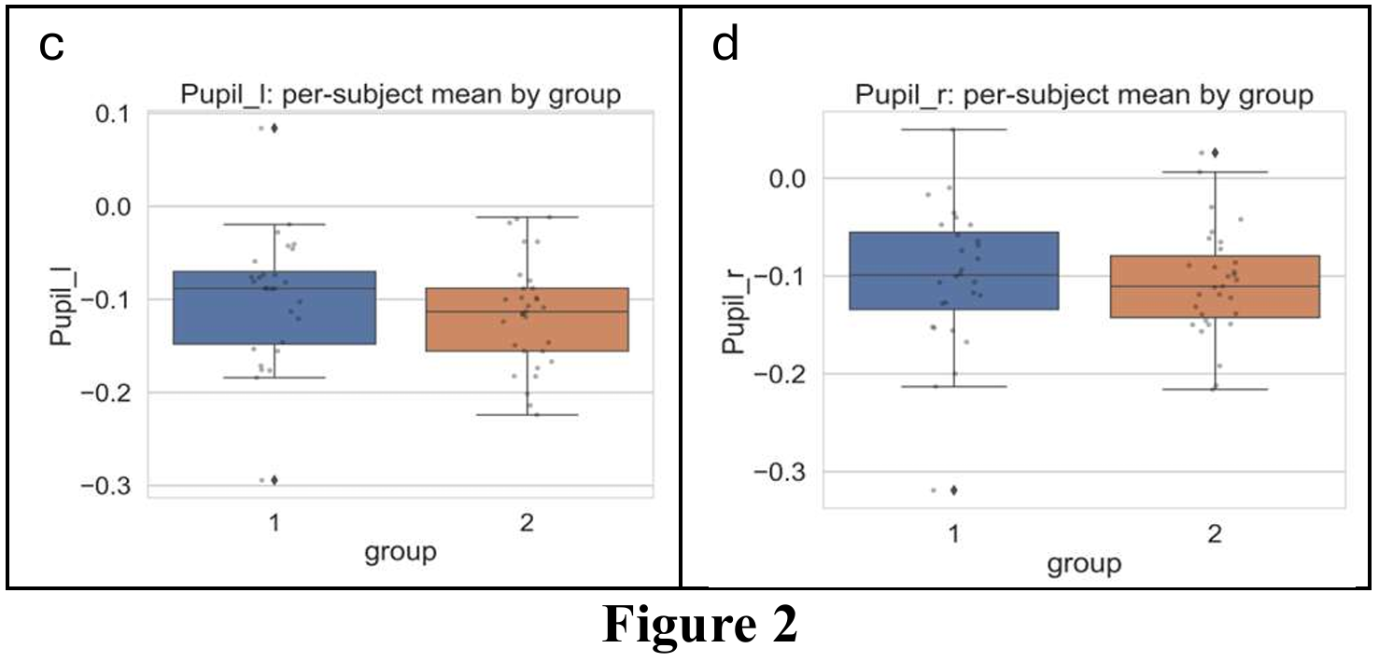
Results and Outputs
Temporal Dynamics of Pupil Response
Healthy adults showed strong, clear pupil constriction and quick recovery, whereas late-life depression patients showed weak, near-baseline constriction with slow re-dilation. This bilateral reduction in pupil modulation reflects diminished parasympathetic activation and autonomic flexibility, independent of task performance.

Slide 10
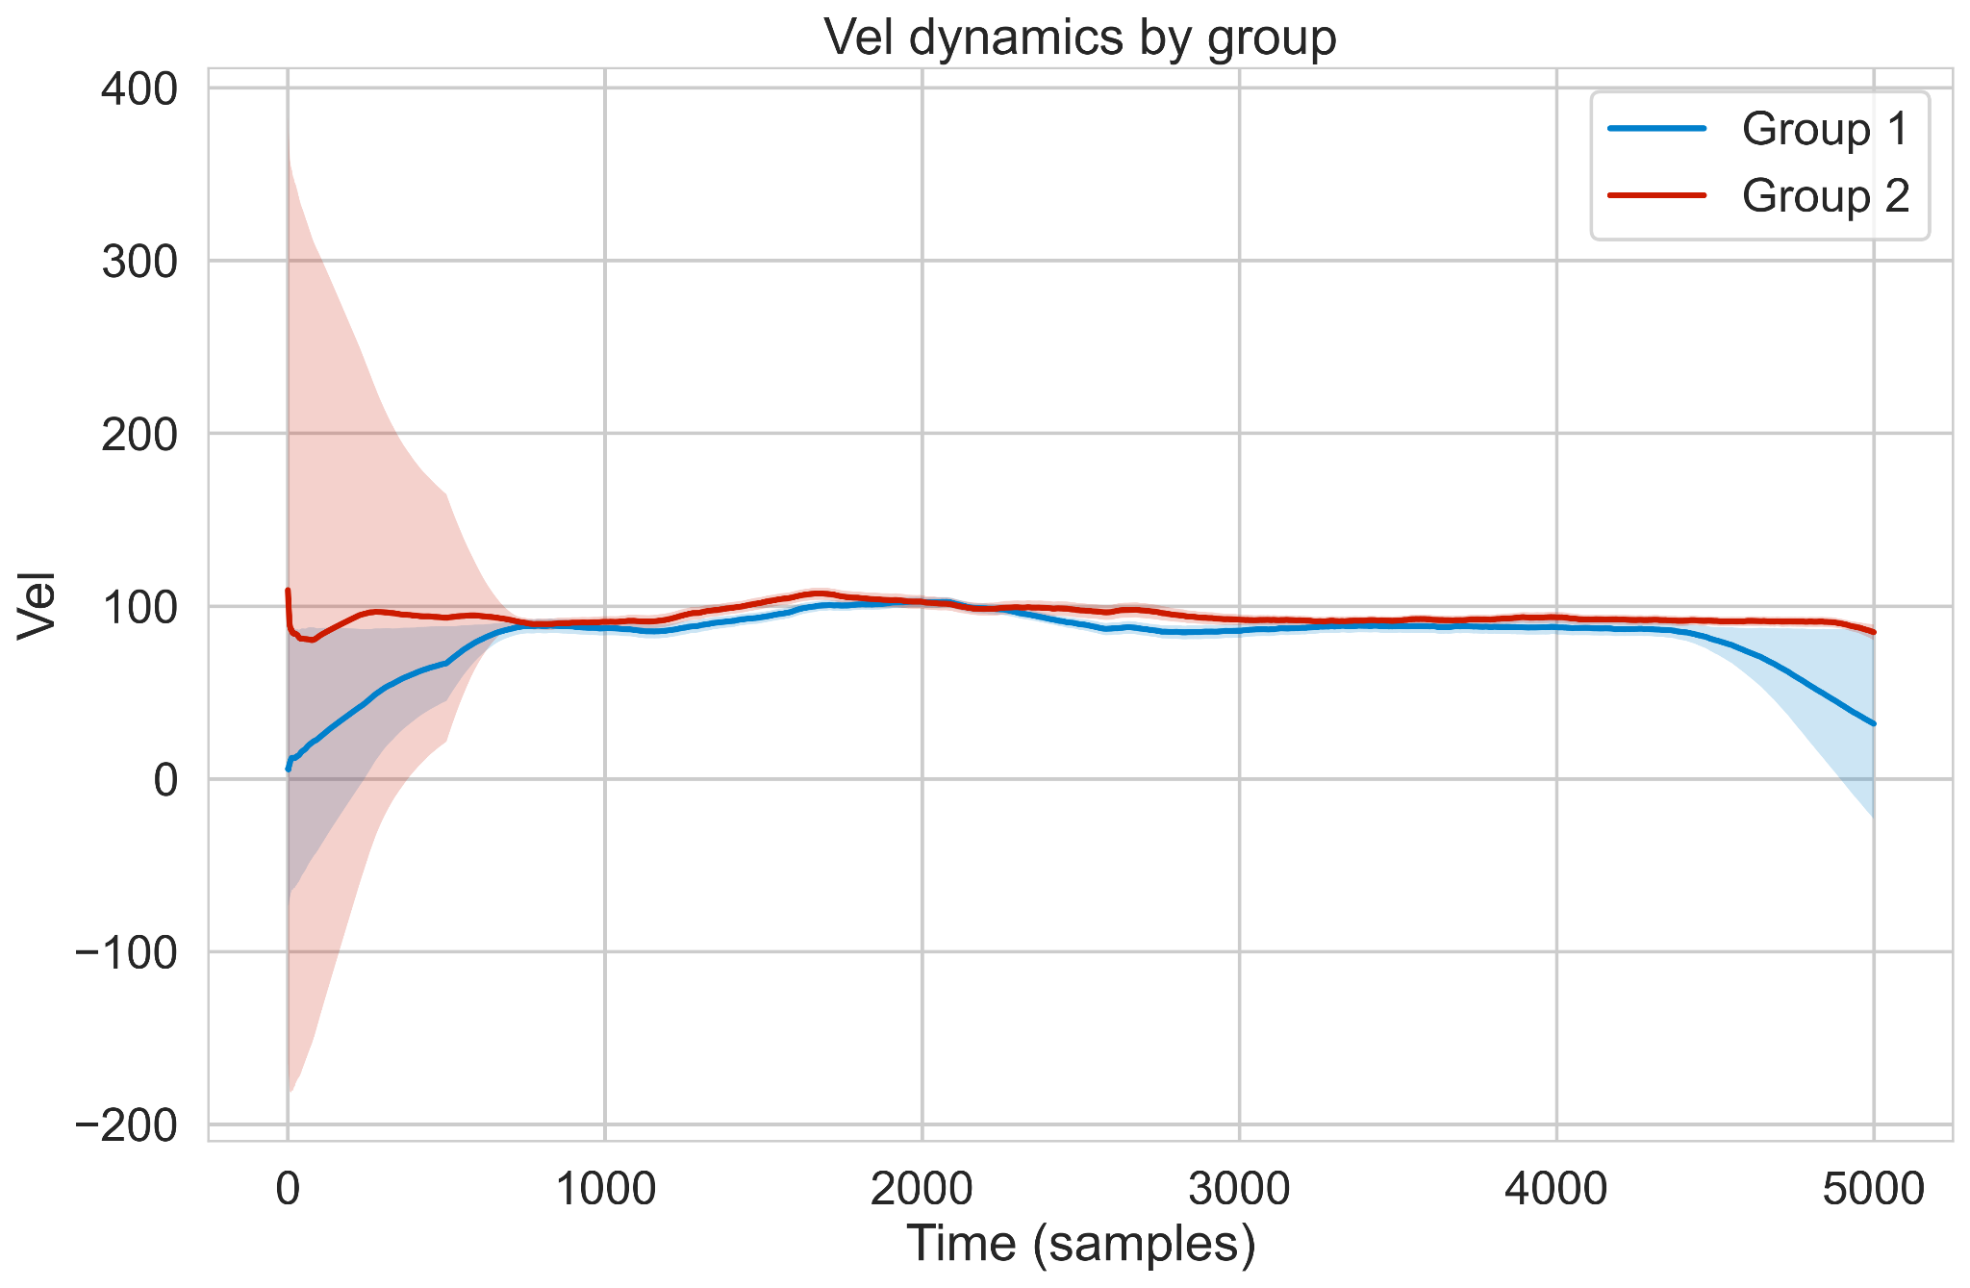
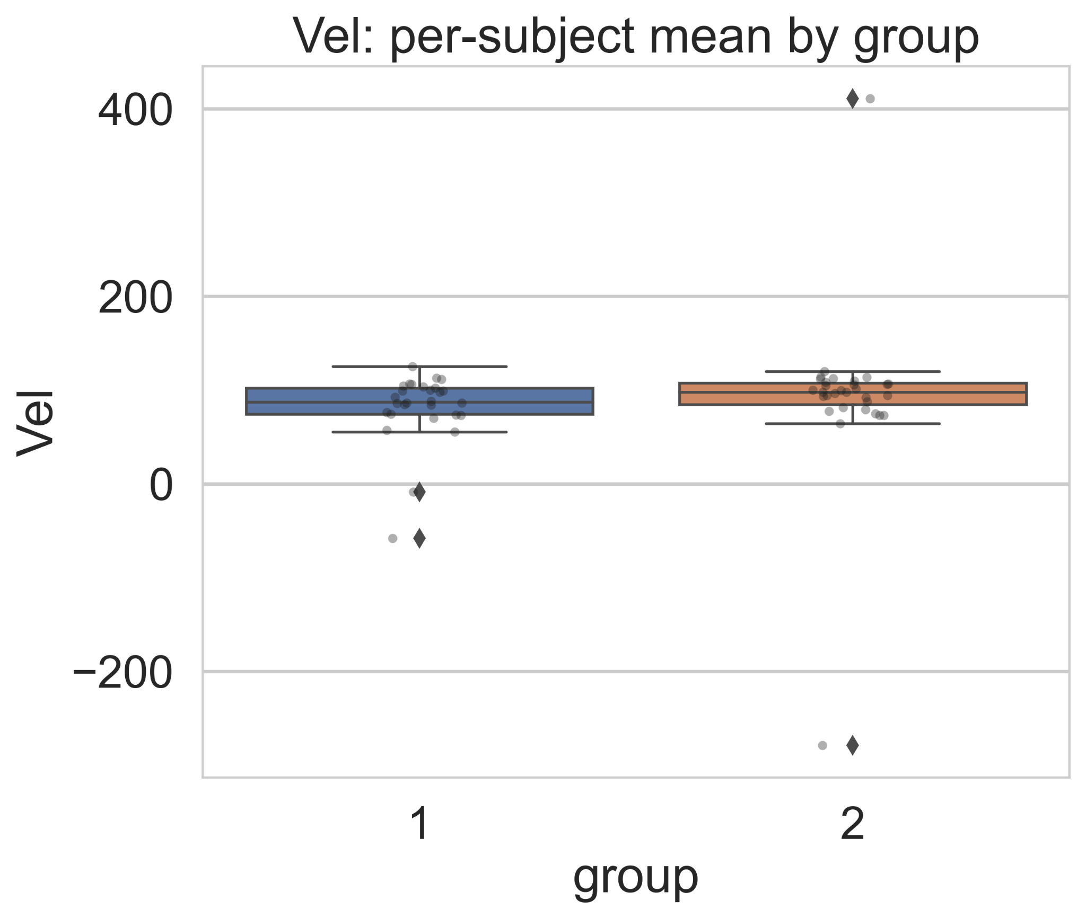
Temporal Dynamics of Saccadic Velocity
Saccadic velocity remained similar between healthy adults and individuals with late-life depression, with both groups showing comparable time-course patterns and peak velocity distributions. No significant differences or abnormalities were observed, indicating preserved neuromotor pathways for generating saccades in LLD. While other measures like pupil response and microsaccades showed group differences, the speed of intentional saccades remained unaffected, suggesting that oculomotor execution is intact in late-life depression.

Slide 11
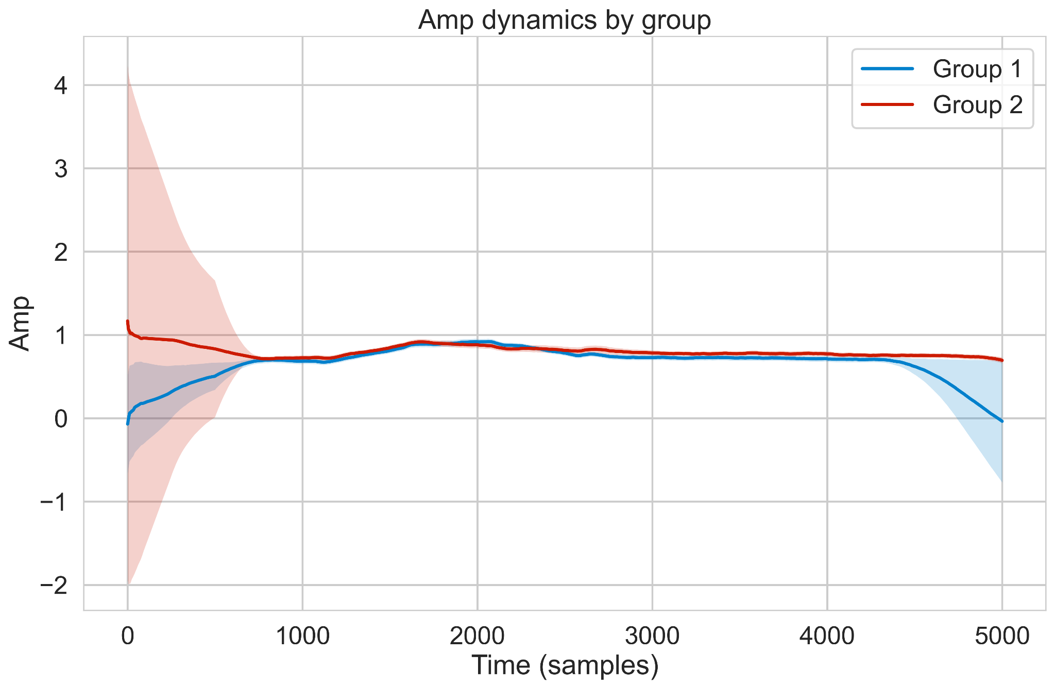
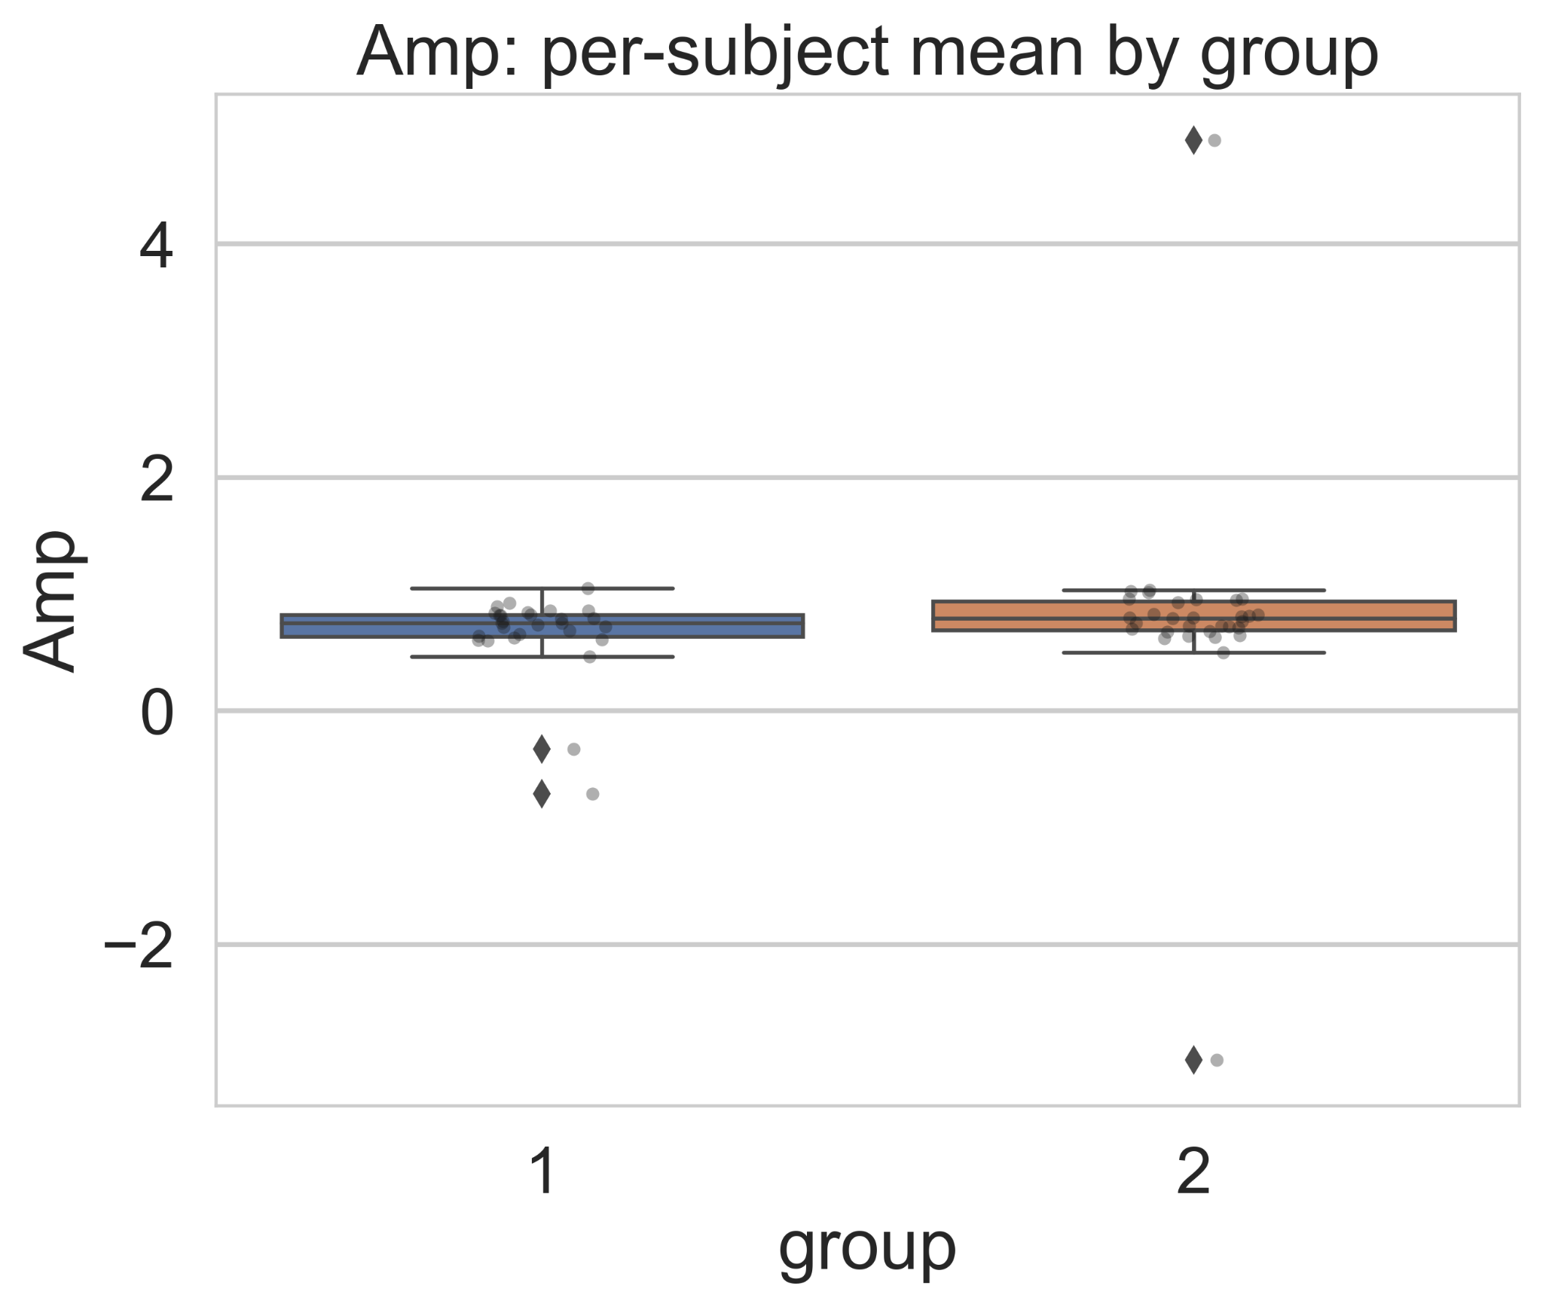
Temporal Dynamics of Saccadic Amplitude
Saccadic amplitude remained stable and comparable between healthy adults and individuals with late-life depression, with no group-specific deviations across the entire time window. Boxplot distributions showed similar medians and variability, indicating preserved spatial control of saccadic movements. These results suggest that LLD does not affect the basic motor mechanisms governing saccade amplitude, with differences instead appearing in finer attentional and autonomic processes rather than core oculomotor execution.

Slide 12
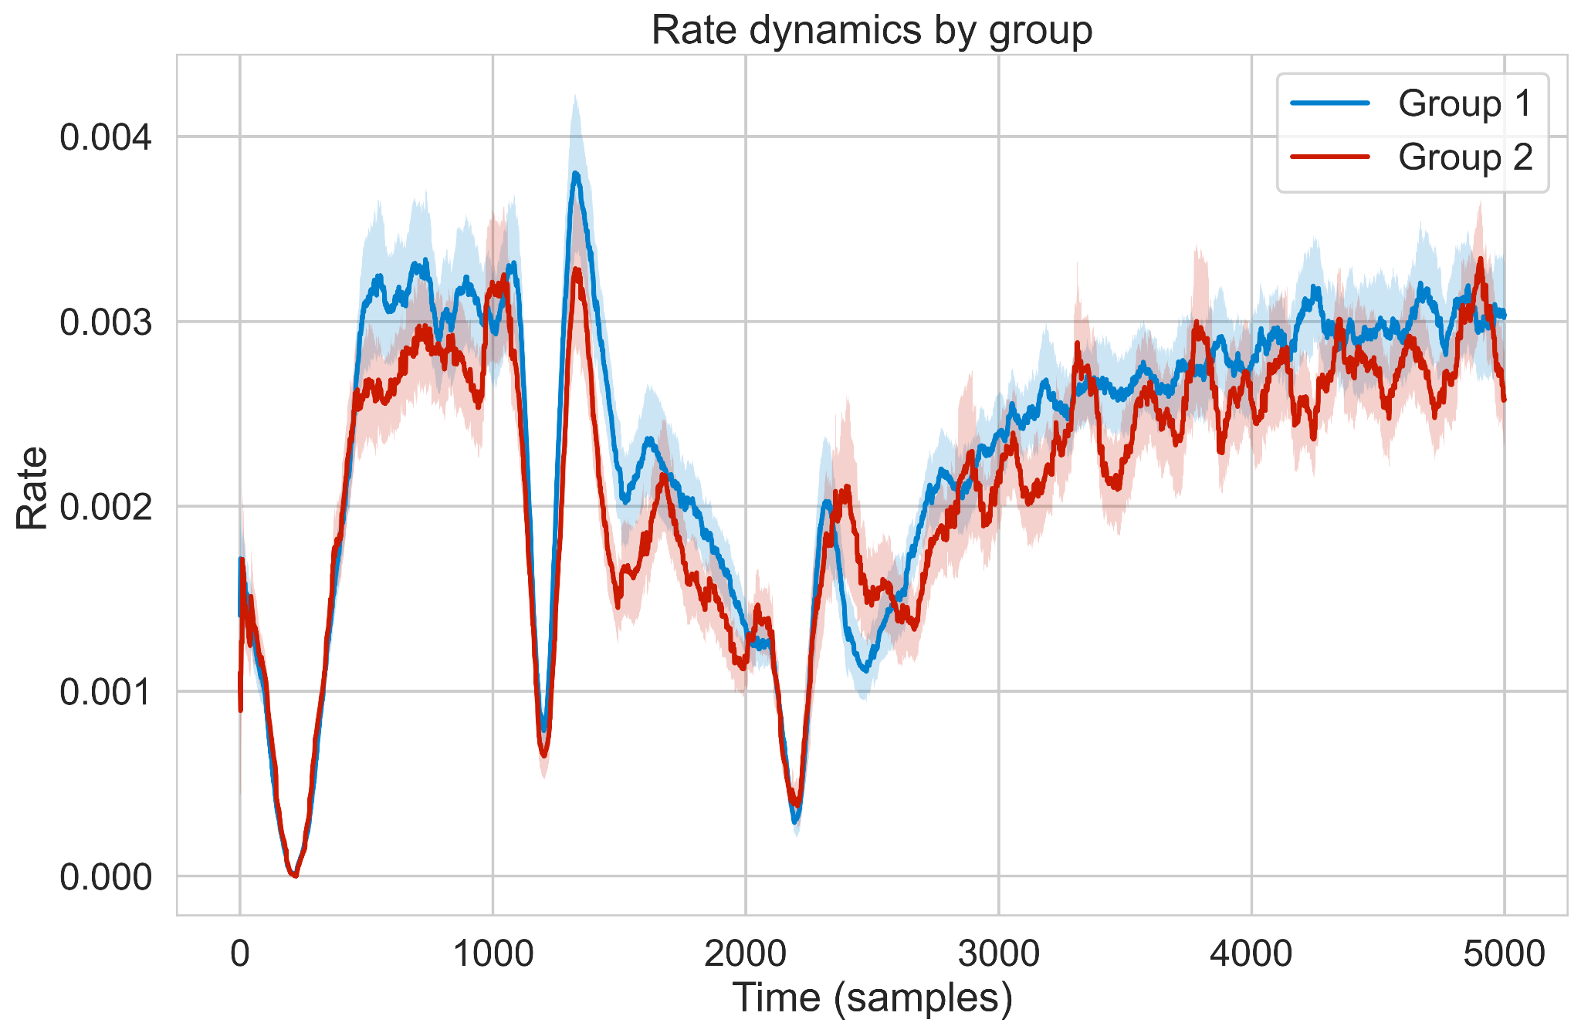
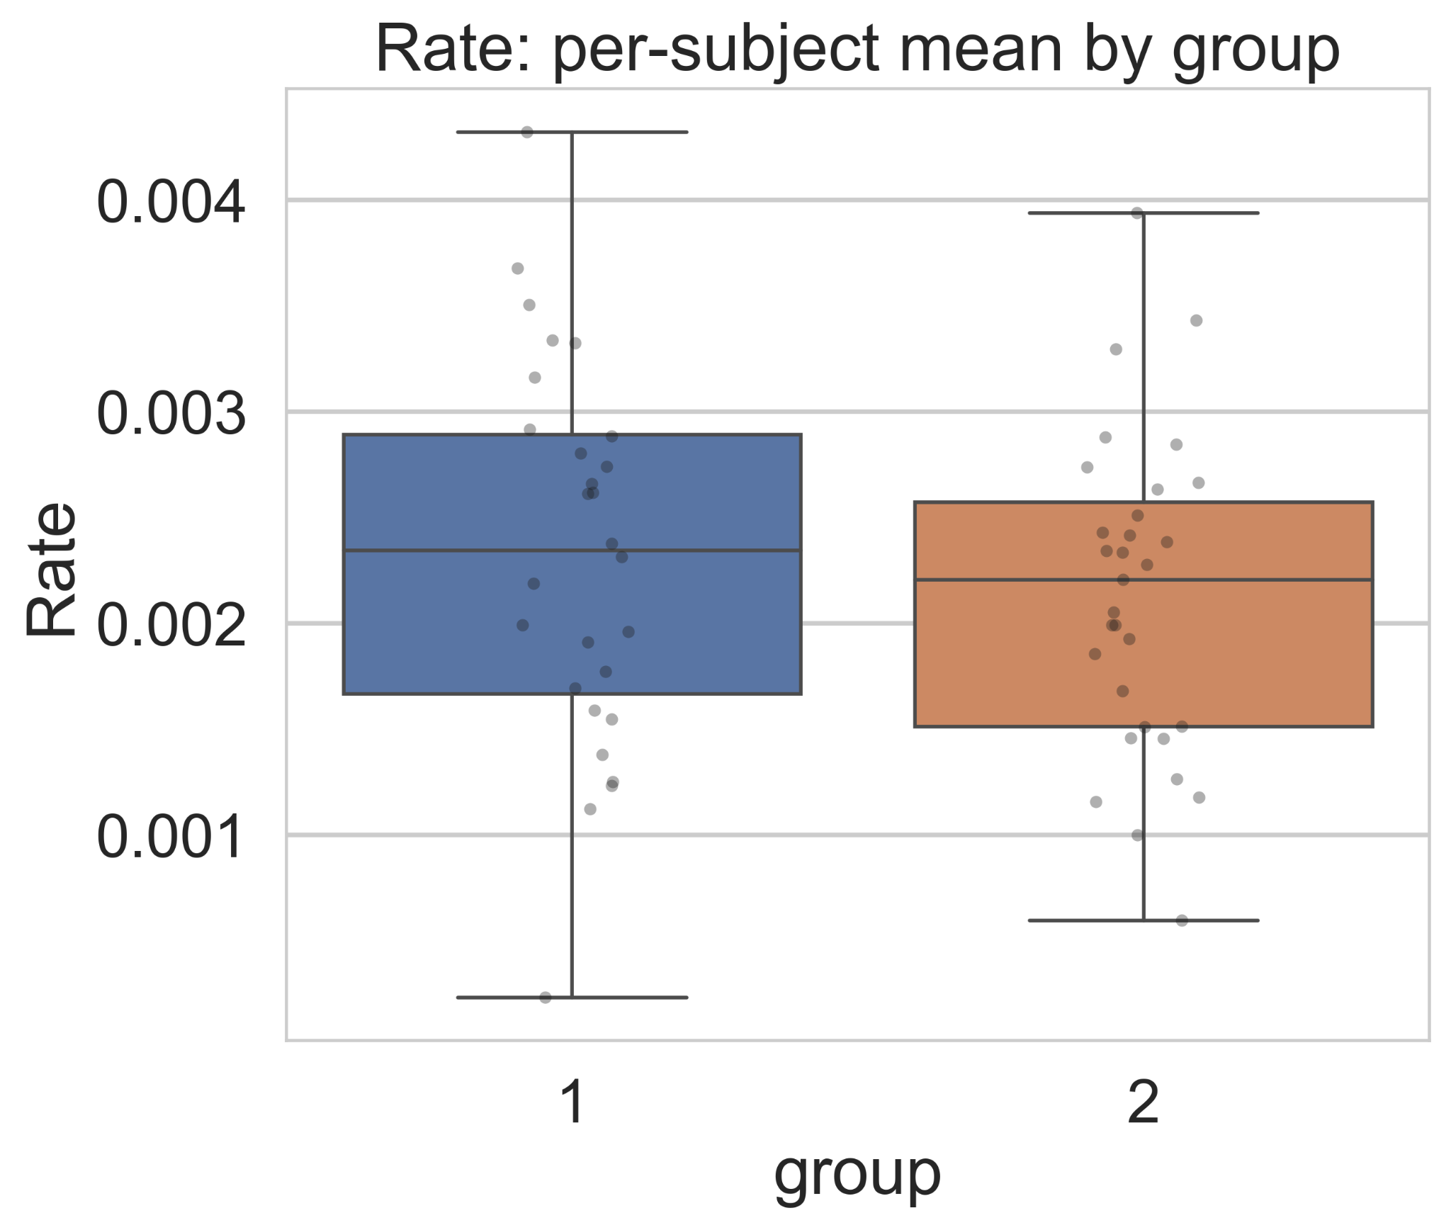
Temporal Dynamics of Microsaccade Rate
Individuals with late-life depression showed consistently higher microsaccade rates across the entire time window, indicating reduced fixation stability and impaired moment-to-moment attentional control. Boxplots confirmed significantly higher and more variable microsaccade frequencies in the LLD group compared to controls. Unlike preserved saccade amplitude and velocity, this fine-scale oculomotor disruption highlights altered superior colliculus–related attentional regulation in late-life depression.

Slide 13
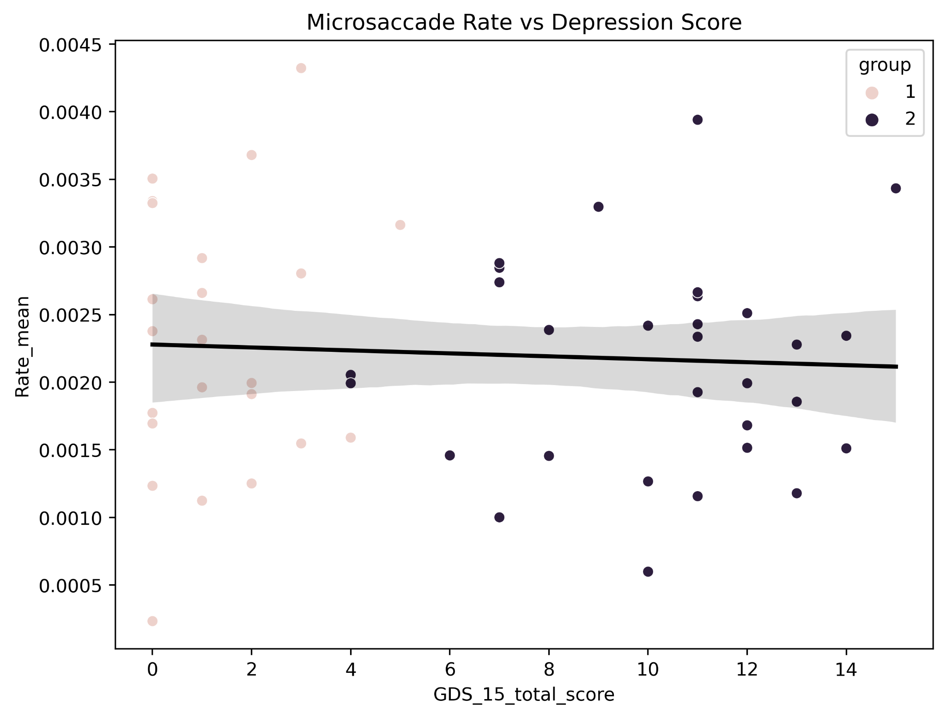
Symptom-Dependent Modulation of Microsaccadic Activity
Microsaccade rate was consistently higher in individuals with late-life depression, but it did not vary with the severity of depressive symptoms, showing no linear relationship with GDS-15 scores. Healthy controls clustered at lower microsaccade frequencies, while all LLD participants showed elevated rates, indicating a categorical rather than dimensional marker. These results suggest that fixation instability and attentional dysregulation are key features of LLD, while fundamental oculomotor functions remain intact. Pupillary and microsaccade measures together provide sensitive physiological indicators of depressive status in older adults.

Slide 14
Behavioral Performance: Both groups showed high, equivalent accuracy and reaction times, ensuring physiological differences were not due to engagement or cognitive load.​
Pupil Responses: Healthy controls exhibited sharp bilateral pupil constriction, quick recovery, and strong parasympathetic modulation. LLD participants had reduced constriction, lower peak amplitude, and slower recovery, indicating autonomic dampening and locus coeruleus-noradrenergic dysfunction.​

Slide 15
Microsaccade Rate: LLD group showed consistently higher microsaccade frequencies throughout stimulus processing, reflecting impaired fixation stability and attentional control. Differences were stable across symptom severities, suggesting the rate as a categorical biomarker.
Saccadic Velocity and Amplitude: No significant differences between groups; neuromotor mechanisms for saccade execution remain intact in LLD, with deficits arising in fine-level oculomotor regulation rather than large-scale motor control.​

Slide 16
Summary Metrics: Distribution analyses (boxplots) confirm findings for pupil constriction (lower in LLD), saccadic kinematics (comparable), and microsaccade rate (higher in LLD, no correlation with severity).​
Implications: Simultaneous analysis reveals selective impairment in arousal-related control and fixation stability in LLD, supporting the use of eye-tracking and autonomic measures as sensitive diagnostic tools.

Slide 17
Conclusion
The study confirms that integrated analysis of eye-tracking and autonomic signals identifies unique, objective patterns in older adults with late-life depression, distinct from healthy controls.​
Microsaccade rate and blunted pupil constriction serve as non-invasive, scalable physiological biomarkers for diagnostic and research use in geriatric mental health.

Slide 18
Future Scope
The research recommends enlarging and diversifying the dataset, including additional emotional stimuli and trial paradigms, and developing robust multimodal machine learning models for classification and risk stratification in depression.​
Future work will focus on mechanistic inference (sympathetic/parasympathetic decomposition), cross-site validation, and prospective studies for clinical translation and longitudinal monitoring in mental health workflows.

Slide 19
References
Engbert, R., & Kliegl, R. Microsaccades uncover the orientation of covert attention. Vision Research, 43(9), 1035–1045 (2003).
Rolfs, M. Microsaccades: Small saccades with big consequences. Vision Research, 49(20), 2415–2441 (2009).
Wang, C.-A., & Munoz, D. P. A circuit for pupil orienting responses: Implications for cognitive neuroscience. Trends in Neurosciences, 38(9), 556–571 (2015).
Joshi, S., & Gold, J. I. Pupil size as a window on neural substrates of cognition. Trends in Cognitive Sciences, 24(6), 466–480 (2020).
Aston-Jones, G., & Cohen, J. D. An integrative theory of locus coeruleus–norepinephrine function. Annual Review of Neuroscience, 28, 403–450 (2005).

Slide 20
McGinley, M. J., David, S. V., & McCormick, D. A. Cortical membrane potential signature of optimal states for sensory signal detection. Neuron, 87(1), 179–192 (2015).
Bradley, M. M., Miccoli, L., Escrig, M. A., & Lang, P. J. The pupil as a measure of emotional arousal and autonomic activation. Psychophysiology, 45(4), 602–607 (2008).
Beatty, J., & Lucero-Wagoner, B. The pupillary system. In Handbook of Psychophysiology (pp. 142–162). Cambridge University Press (2000).
Thayer, J. F., Åhs, F., Fredrikson, M., Sollers, J. J., & Wager, T. D. A meta-analysis of heart rate variability and neuroimaging studies: Implications for HRV as an index of top–down self-regulatory mechanisms. Neuroscience & Biobehavioral Reviews, 36(2), 747–756 (2012).
Boucsein, W. Electrodermal Activity. Springer (2012).
Etkin, A., Egner, T., & Kalisch, R. Emotional processing in anterior cingulate and medial prefrontal cortex. Trends in Cognitive Sciences, 15(2), 85–93 (2011).

Slide 21
Thank You

